Slide 1
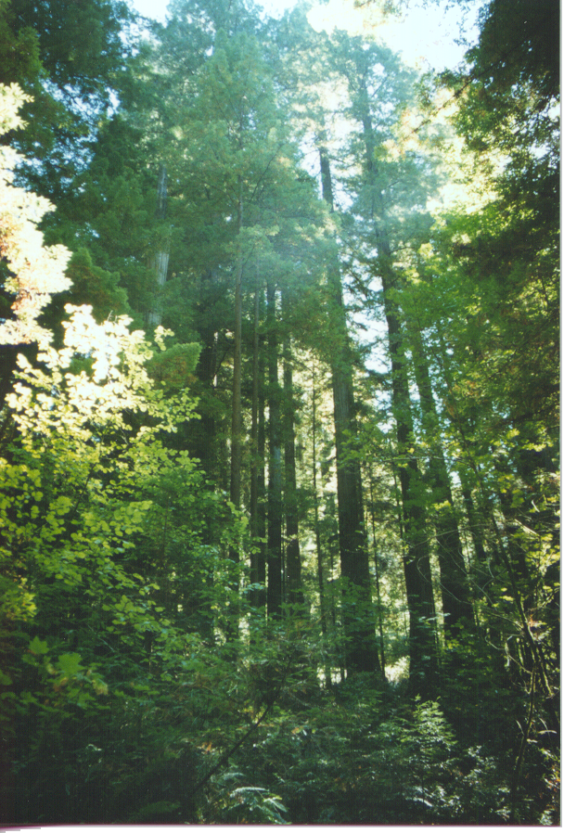
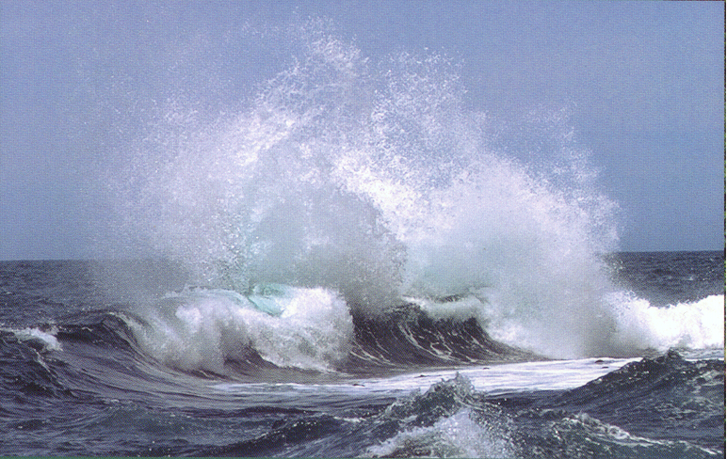
The carbon cycle
1
The atmosphere holds about 750 GtC
Dead Organisms
The oceans hold about 40,000 GtC
Fossil Carbon
Vegetation holds about 600 GtC Soils hold about 1600GtC
Notes:
1

Slide 2
The active carbon cycle
The carbon dioxide cycle is a natural one ,and one that has been in dynamic balance and undergone many fluctuations and cycles over millions of years.
There is a balance between the seas and the land and the atmosphere. Carbon is locked up in the seas in plankton and other marine life, and dissolved in the water. Carbon is also locked up in plant matter on the earth (active carbon cycle), and in fossil deposits (inactive carbon cycle) of oil, natural gas, and coal.
The destabilising factor in the carbon cycle is that we have taken the locked up (inactive) carbon from fossil fuels and put that carbon in the atmosphere. The land and the sea carbon sinks are unable to absorb this excess carbon.
Source: Ron Oxburgh ex Chairman of Shell Oil
GtC = Gigatons of Carbon

Slide 3
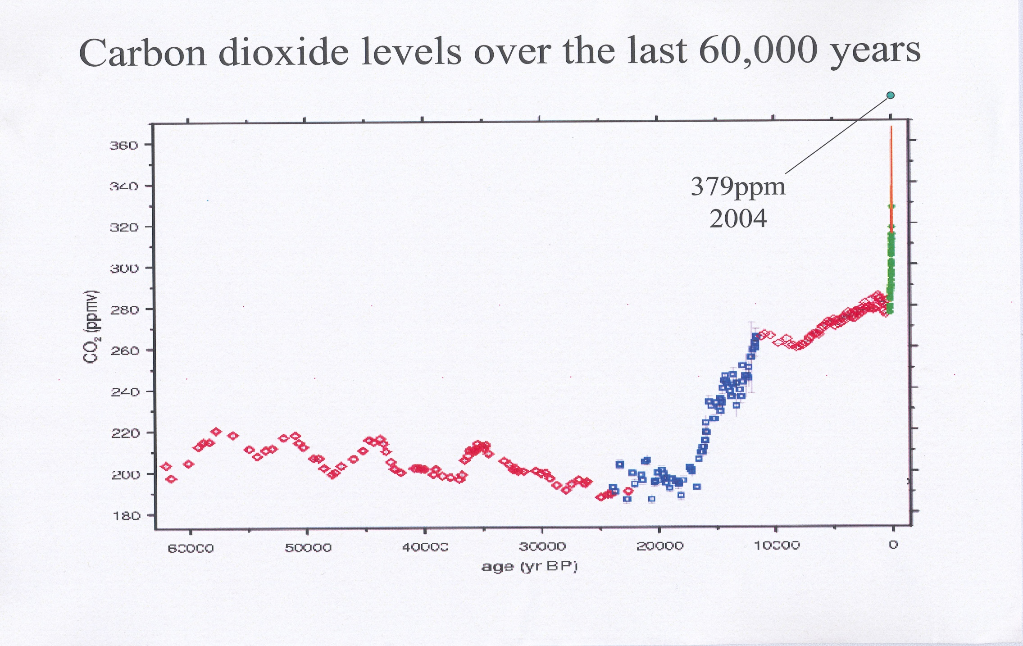
CO2 levels over the past 60000 years
2
381 ppm
2006
Ron Oxburgh
Transition Training 2007
Notes:
3

Slide 4
The natural carbon cycle and human effects
Main points
This shows the ice core data measuring atmospheric CO2 concentrations over the last 60,000 years. As you can see CO2 levels have risen and fallen. To keep the climate from warming more than 2 degrees C we would have to keep CO2 concentration to below 350ppm.
It is currently at 387ppm without counting the other GHG which are Methane, nitrous oxide, CFCs.
Additional Points
The last ice age ended 20,000 years ago with a rise in CO2, and if we went back a few 100,000 years we would see this pattern of rise and fall. What happens next (in red) shows the result of a new agricultural system, and human population increase, and then the green shows the beginning of the industrial era and the burning of fossil fuels. The orange is the 20th & 21st century.
Source Tyndall Centre

Slide 5
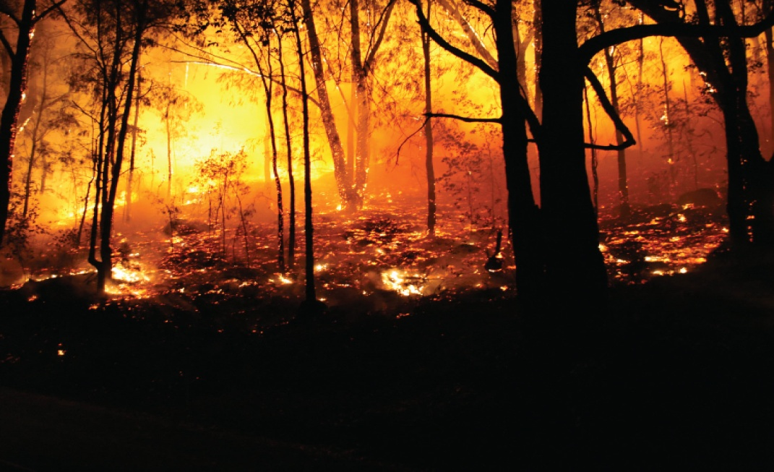
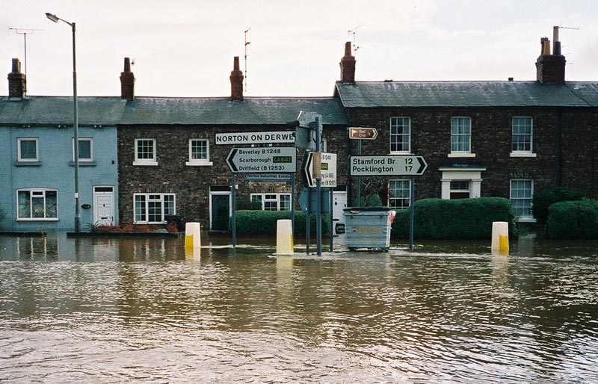
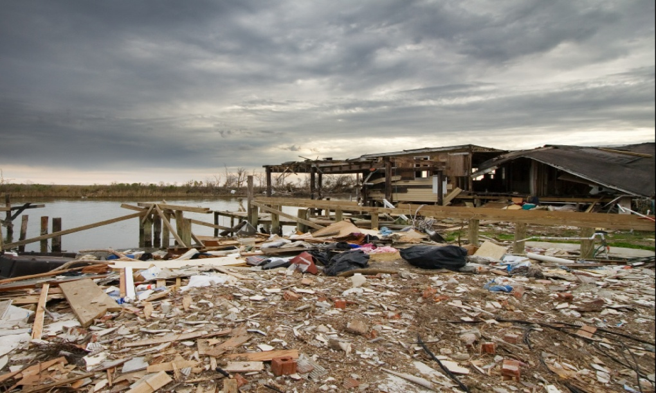
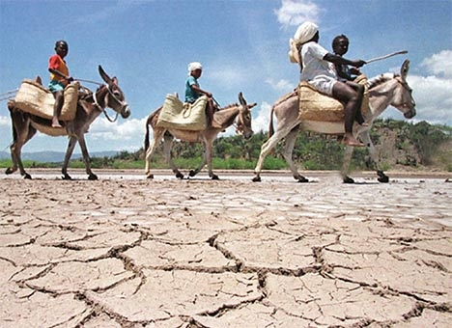
What is climate change?
3
Transition Training 2007
Notes:
5

Slide 6
Climate Change is the global shift from one stable, and benign, climate state to another hotter and more extreme climate state. It is clear that our climate fluctuates both within the current climate state and has been much hotter and colder than the present climate state we have enjoyed over the last 13,000 years.
What is causing the Climate to change now?
Rising human made CO2 and other green house gasses in the atmosphere.
Is it a theory?
Yes
Why?
Because it is trying to establish two ‘cause and effects’. Firstly that rising atmospheric levels of CO2 (and other green house gasses) are the cause of climate change and secondly that humans are causing it through the burning of fossil fuels.
Source: Wikipedia

Slide 7
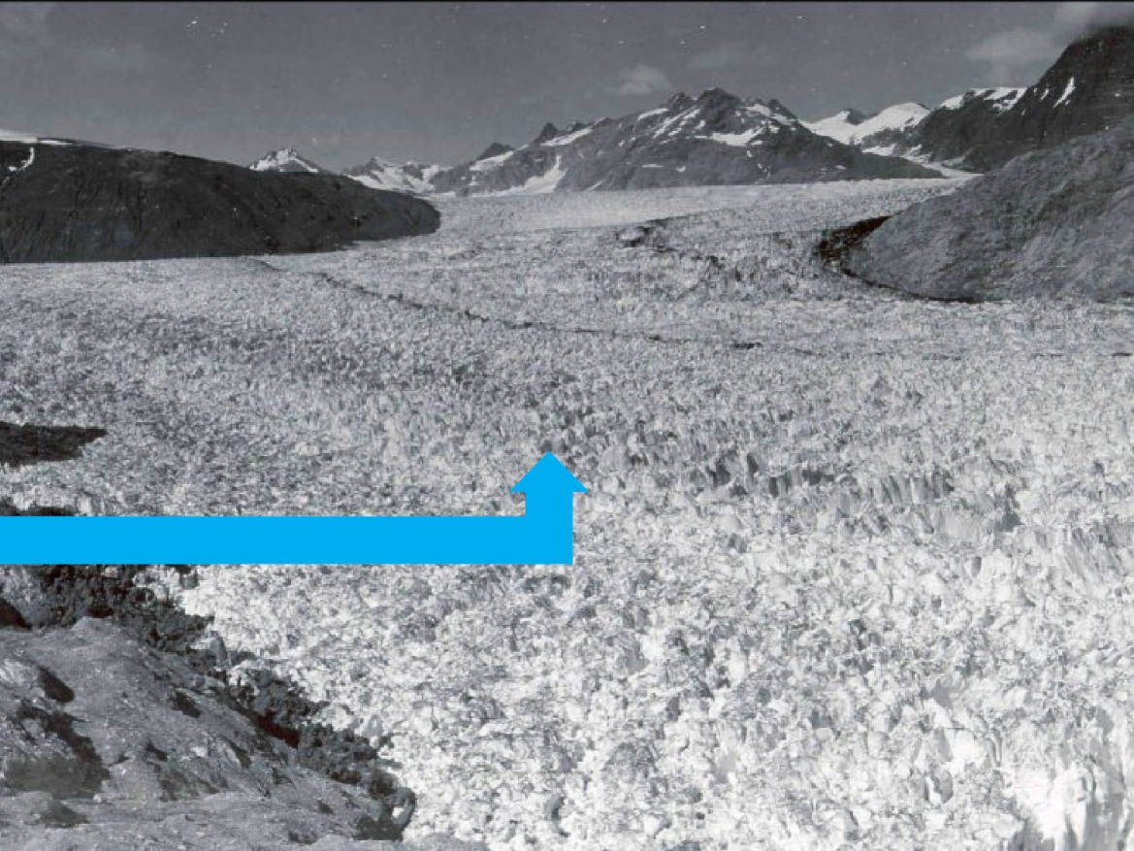
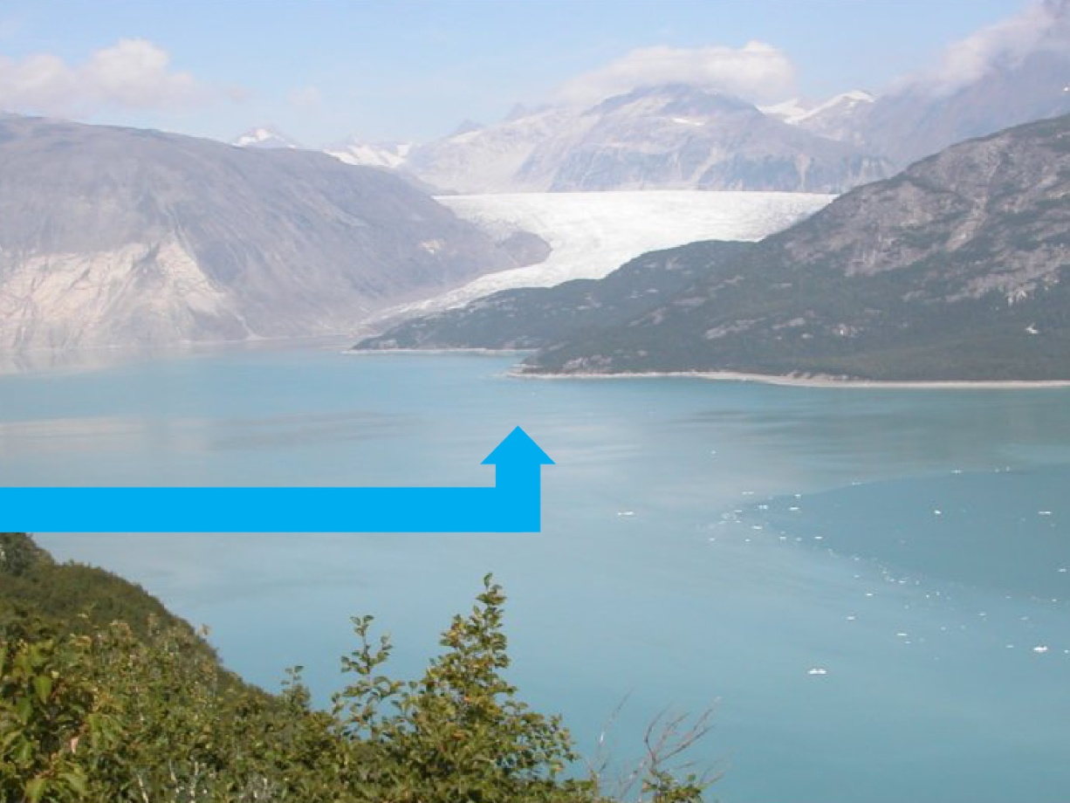
Have we proved the Climate is Changing?
4
MUIR & RIGGS GLACIER 1941
MUIR & RIGGS GLACIER 2004
Transition Training 2007
Notes:
7

Slide 8
Have both ‘cause and effects’ been ‘proven’? Is the earth warming, and are humans causing it?
Main Point
A theory can never be proven but the weight of evidence in favour of both these statements is now becoming overwhelming.
Detail
The 4th IPCC report published in 2007 states,
“ 1-Warming of the climate system is unequivocal.
2-Most of the observed increase in globally averaged temperatures since the mid-20th century is very likely (confidence level >90%) due to the observed increase in human greenhouse gas concentrations.”
This United Nations study, which was just awarded the 2007 Nobel peace prize, was the most comprehensive study of peer reviewed climate research ever undertaken, and one of the most comprehensive studies of any scientific question ever. Its conclusions are that “Unmitigated climate change would, in the long term, be likely
to exceed the capacity of natural, managed and human systems to adapt.”
Source: IPCC 2007 Climate Change Synthesis Report

Slide 9
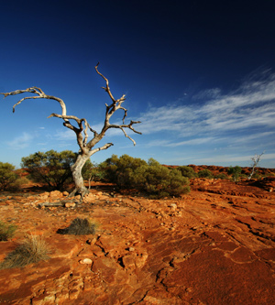
What are the main problems with out of control (runaway) Climate Change?
5
Transition Training 2007

Slide 10
What are the main problems with out of control CC?
Main Points
Severe ‘one in a hundred year’ weather events becoming common
Sea level rises, leading to increasing land loss and climate change refugees
Species loss
Additional Points
Increased droughts/desertification. This slide is of the Australian Murray River system, which has faced an extreme multi year drought. The government has had to take the decision to allocate whatever water there is to the cities rather than allow farmers to irrigate their crops. This has lead to a decrease in the Australian wheat harvest in 2007 . Australia is one of the bread baskets of the world.
Increased floods- such as the summer of 2007 in the UK .
Acidic seas
Species loss due to temperature zones migrating This will accelerate species loss due to habitat loss, as many species of plants and animals will be unable to migrate with the temperature. We face a potential of 50% or more loss of life on earth. We are depended on the web of life for our survival.
Source: Guardian.co.uk; USA National Academy of Sciences
Transition Training 2007
Notes:
10

Slide 11
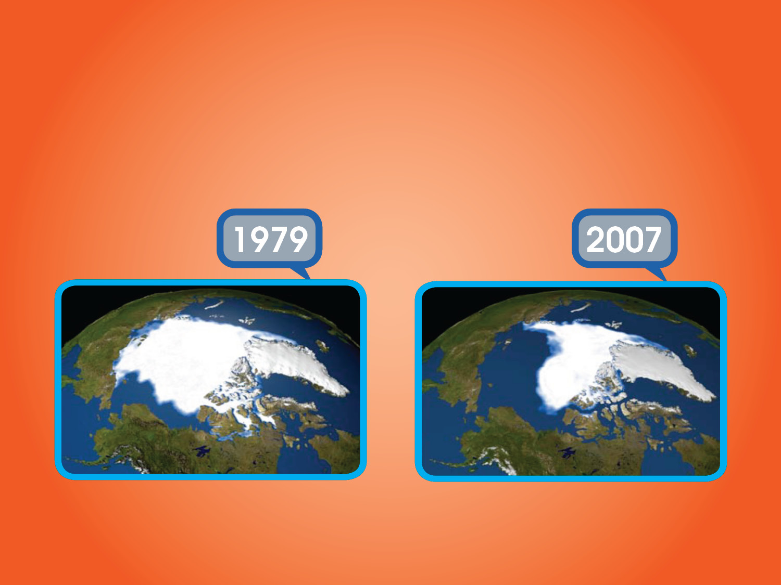
The need for an urgent response
6
Transition Training 2007
Notes:
11

Slide 12
The need for an urgent response
Once global temperatures rise to certain levels positive feedback loops will cause further releases of greenhouse gases, leading to runaway climate change
On the best evidence we need to keep temperature rises to less than 2* C to prevent this from happening.
Emissions already made have not yet had their full impact – so we are perilously close to reaching this even if we reduce emissions dramatically now.
An example of a positive feedback loop
For example if the arctic tundra melts it will emit so much methane, a powerful green house gas, that it will dwarf human CO2 emissions.
Source: DR James Hansen NASA climatologist

Slide 13
Responses to Peak Oil & Climate Change
7
Peak Oil + Climate Change
=
Systems Re-think
Planned Relocalisation
Energy Descent Pathways
Resilience thinking and acting
Change in land-management
PEAK OIL
Burn everything!
relax drilling regulations
More biofuels
Exploit tar sands and non-conventional oils
Convert coal to liquid fuel
CLIMATE CHANGE
Climate engineering
Carbon capture and storage
International emissions trading
Nuclear power
High Tech or Green Tech solutions
Transition
Notes:
In terms of devising mitigation actions, it’s important to look at Peak Oil and Climate Change together. If you look at them in isolation, you get one dimensional solutions.
On the one hand, Peak Oil on its own might demand (as suggested by the Hirsch report for the US administration) all sorts of actions to maintain “business as usual”
On the other hand, Climate Change can often prompt actions that address carbon emissions at a global scale (though nuclear power is questionable even if you focus purely on its carbon equation).
So where does "peak oil" leave the Stern review? The intuitive answer is that running out of oil should at least be good for climate change, but the reverse could be true. A growing shortfall of global oil production is likely to send the crude price skywards, obliterating Stern’s grand bargain. The kind of long-term impacts attributed by Stern to climate change could arrive much sooner. With the economy reeling, it will be far harder to fund the expensive new energy infrastructure we need to combat climate change. And faced with the likely re-emergence of mass unemployment, the political priority may well shift from, say, maintaining a high price on carbon, to keeping the lights burning at lowest cost. True, recession would mean we would emit less CO2, but since we have to cut by at least 80+ percent by 2050 (or much sooner according the scientists looking at the effects of feedback mechanism), economic contraction is hardly the optimal way to achieve the target.
He also seems to ignore limitations to the availability of uranium and the carbon costs of this “clean” fuel.
He’s also working towards a CO2 concentration of 550ppm, whereas Hansen & the Tyndall Centre says we must keep it to 450ppm.
However, when you bring them together, the imperative is to build local resilience, address the vulnerability of communities to disruptions in their supply lines and all aspects of national and international grids for energy, money, medicine and food, in particular.
The Transition model focuses wholeheartedly on this middle ground.
And to those who may think of this as a retrograde step – recovering a sense of neighbourhood is not a backward move.

Slide 14
Response to Peak Oil and Climate Change
It’s important to look at whole systems not parts of systems. Trying to solve pieces of problems is the thinking that got us here.
If you were only trying to solve the problem of peak oil you would look for replacements for easy to extract crude oil– tar sands, drilling for hard to produce oil in deep oceans, exploiting bio fuels, turning coal to liquids.
Similarly if you were only trying to solve climate change issues you may look for energy intensive solutions to mitigate climate change, including nuclear energy.
When PO and CC are looked at together it quickly becomes apparent that you have to redesign the system – a low energy, re-localised and resilient system is the only viable future. There are many other parts of the system that are in crisis, but the minimum you need to look at to get that we need a systems rethink is peak oil and climate change.
Source: Transition Training

Slide 15
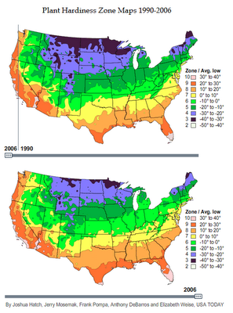

Slide 16
Has the Continental US
Been Impacted by Climate Change?
YES! This image compares the Hardiness Zones of the US in 2006 and 1990.
The zones are based on ranges of mean low temperature.
The following image reveals that many of the zones have moved
North 100-150 miles since 1990
Source: USA Department of Agriculture

