Slide 1
Peak oil
1

Slide 2
Peak oil- What is it?
Peak oil is the point at which we can no longer increase the amount of crude oil we extract and globally petroleum production goes into irreversible decline. It is not when the oil runs out!
This typically happens when an oil province has extracted roughly ½ of all the oil that is ever going to be extracted from that province . Every oil province has followed this pattern, so it follows that at some point a global oil production will follow a similar pattern.
This slide illustrates why the sum total of a collection of oil fields in a region when added together creates a peak at about the half way point in production
Source: Liverpool University School of Management

Slide 3
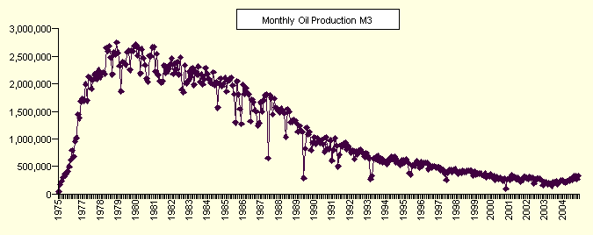
2
Two typical oil fields
Forties field UK sector North Sea
Source: ASPO Switzerland
Prudhoe Bay, Alaska
Source: www.davidstrahan.com

Slide 4
Peak oil - What is it?
Oil field production
These two large oil fields illustrate the basic dynamics of oil production – and extraction of any non renewable resource:
A steep initial increase, a production plateau and then a slow but irreversible decline.
Once the peak is past there are many techniques and technologies that can maximise the declining output, but production will never return to it former levels. Once it peaks it peaks!
Source: The Association for the study of Peak Oil

Slide 5
Oil production follows discovery
3
USA
Russia
Egypt
Indonesia

Slide 6
Peak oil - What is it?
Oil production Follows Discovery
These graphs illustrates that in oil producing countries the production peak follows the discovery peak, usually 25-40 years later.
In country after country and oil province after oil province the pattern is broadly the same . These four examples show countries that have peaked. The pattern, both of discovery and production, is broadly the same, sharp initial increase, bumpy plateau, and then decline.
Globally we are now discovering 1 barrel of oil for every 5 or 6 that we use, so are well down the discovery peak which occurred over 40 years ago- how long until we hit the global production peak?
Discovery in billions of barrels & production in thousands of barrels per day
Source: Colin Campbell

Slide 7
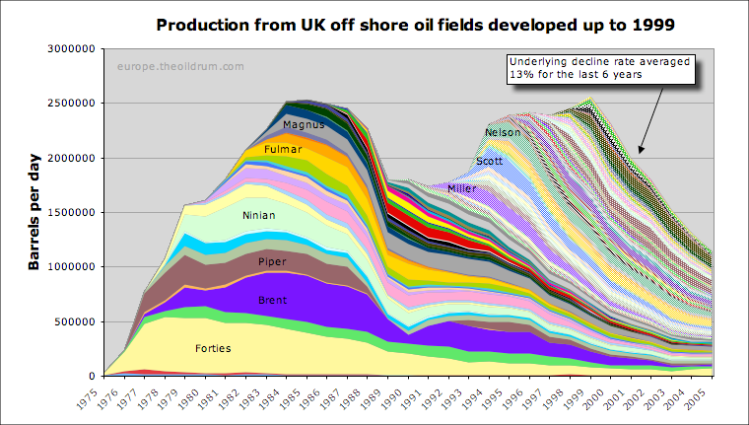
UK production profile
4
Transition Training 2009

Slide 8
When will it happen? UK Oil production profile
This is the pattern in the UK, showing oil production from the North Sea.
Each coloured band shows a different oil field
Britain’s production peaked in 1999 and is now in steep decline.
Britain’s oil and gas will be virtually gone by 2020.
Source: europe theoildrum.com
Notes:
Additional points: Britain’s Energy Crisis
We are facing a crisis in energy ‘security of supply’, as we will be more less totally dependent on Russia for our gas by 2020, and oil from the Middle East. We are currently importing up to 20% of our gas from Norway, and by next year importing liquefied natural gas from Qatar.
This over reliance on the middle East and Russia- which has shown its willingness to use its energy resources as a political weapon is very worrying- and our balance of payments is adversely effected.

Slide 9
Global oil discovery and production
5

Slide 10
Peak oil – When will it happen?
Global oil discovery, production and demand
To produce oil you first have to discover it. World discovery peaked in the late 1960’s and has been falling ever since, and despite rapidly improving and sophisticated, technology, there is no prospect of it ever increasing.
At the same time production has been rapidly rising.
Demand is projected to go on rising, (with production failing to keep up), especially in rapidly industrialising countries like China and India, and is leading to rapidly rising oil prices, such as we had in 2008 and then steep drops. We are facing where world energy supply is increasingly uncertain.
A projected and ever widening energy gap between production and demand is being predicted anywhere from 2011 onwards.
Data: Exxon Mobile, BP,, and International Energy Agency
Notes:
This slide looks at the historical data and the likely projected supply demand and discovery. The key thing is rapid rise of demand coupled with decreasing supply, and ever lower discovery.
Oil production has hit a plateau at around 85 million barrels per day for nearly two years with no signs of it increasing, despite the increased prices and more being spent on exploration.

Slide 11
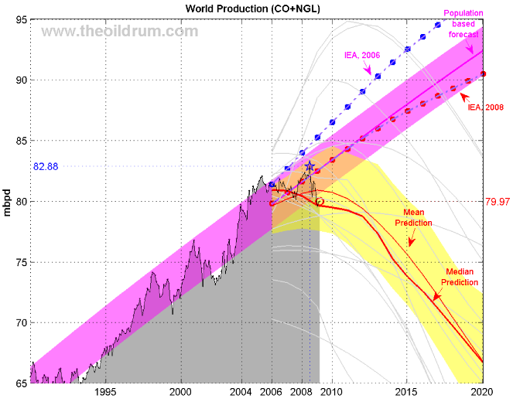
When is the global oil peak?
Crude oil and natural gas liq
Crude oil and natural gas liquids
6
Transition Training 2009

Slide 12
When will it happen? When will global oil production peak?
The argument is when will we peak, not whether. All credible analysts accept that the supply of a non renewable resource such as oil will peak and decline.
This graph represents two diverging stories about future oil production. The official view of the International Energy Agency (IEA) represented in red and blue dotted lines and outlined in magenta, and an opposing view of independent analysts represented by the light gray lines which if averaged give the solid red lines outlined in yellow.
There is a growing conviction amongst independent analysts that we have already peaked, or if not, are likely to before 2011. In contrast the official view of the IEA remains optimistic, but has significantly moved from the blue dotted to red dotted line in their 2006 to 2008 reviews. For the first time, in their 2008 World Energy Outlook, the IEA acknowledged a significant risk that crude oil production would peak before 2020, and in 2009 senior officials admitted off the record that IEA production data was politically influenced and overstated.
Source: IEA World Energy Outlook and theoildrum.com, and The Guardian 10.11.09

Slide 13
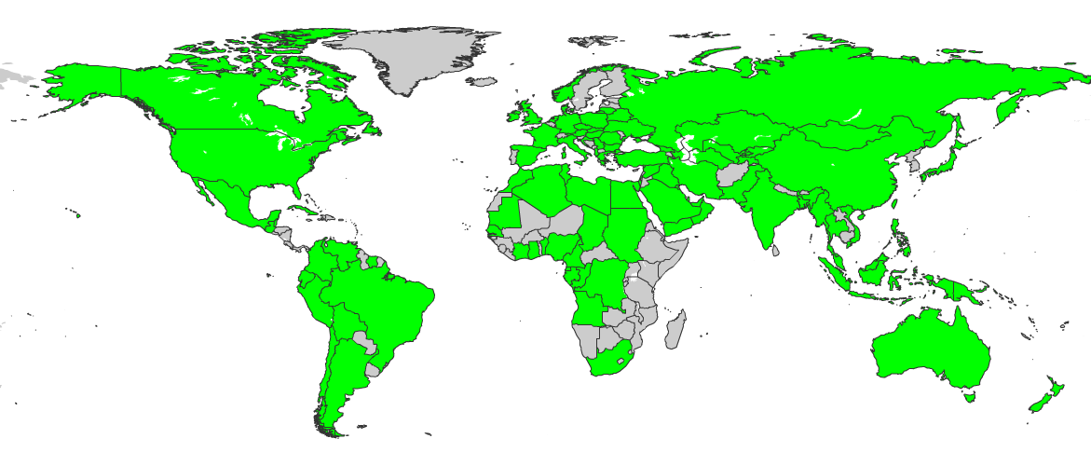
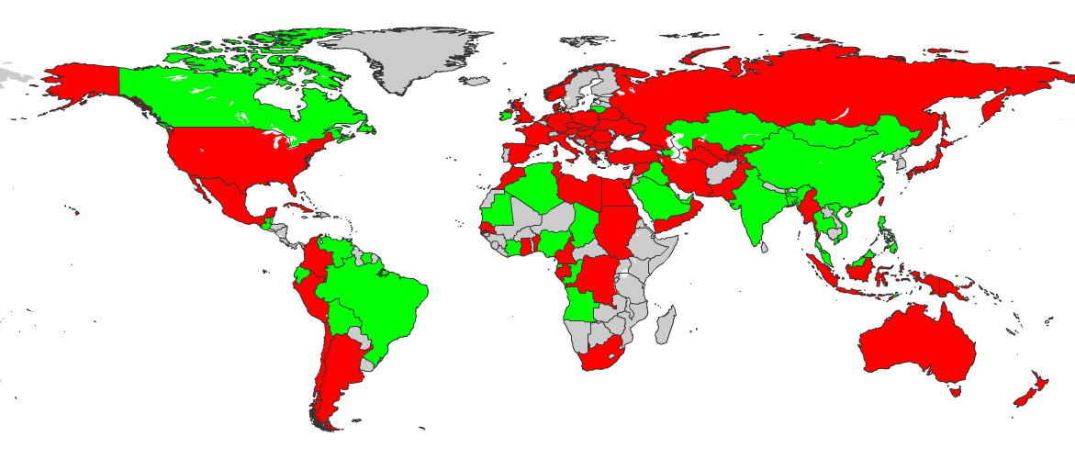
‘Post-peak’ oil producers (64)
Oil producers (98)
7
www.lastoilshock.com
Notes:
64/98 post peak, 60 in terminal decline.
Some odd ones out – like Russia and a couple of the OPEC members – but 60 countries are in outright decline.
- UK peaked 1999 – dropped well over 30%
- Seems to be a new one every year – Mexico and Denmark just gone...
- analyse the world in bigger blocs – OECD has been in decline since 1997, and universally agreed that oil production in the entire world bar OPEC will peak in 2010-ish
- not just peak oil forecasters believe this - also International Energy Agency, US govt, other oil companies, major international oil consultancies – all agree non-OPEC peak early in the next decade.
Russia, USA, Iran, Mexico, Norway, Libya, Kuwait, United Kingdom, Indonesia, Oman, Egypt, Argentina, Columbia, Australia, Syria, Yemen, Denmark, Gabon, Ukraine, Turkmenistan, Romania, Trinidad & Tobago, Peru, Uzbekistan, Cameroon, Bahrain, Germany, Belarus, Israel, Papua New Guinea, Tunisia, Italy, Netherlands, Turkey, Albania, Croatia, Cuba, Austria, France, Pakistan, Hungary, Georgia, New Zealand, Spain, Chile, South Africa, Poland, Myanmar, Congo (Kinshasa), Greece, Serbia & Montenegro, Senegal, Japan, Bulgaria, Surinam, Kyrgyzstan, Tajikistan, Benin, Taiwan, Czech Republic, Ghana, Barbados, Slovakia, Morocco.

Slide 14
Peak oil – When will it happen?
Of the 98 producers 64 countries have already peaked
There are 98 countries in the word that produce oil, some large producers some small.
The countries in red are the countries that are now ‘post peak’.
Their oil production is now in decline and nothing they can do will ever reverse that.
Of 98 producers 64 have already peaked. Anyone who tries to tell you that peak oil is a myth should look at any one of these countries- every single one has followed the pattern of rapid growth in oil production, a ‘Hubbert’s peak’ as production plateaus and then decline.
Source: lastoilshock.com

Slide 15
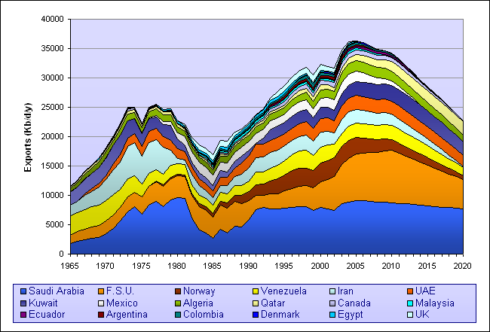
Exports from oil producers
8
Transition Training 2009
Notes:
15

Slide 16
When will it happen? When will Peak oil happen to you? It depends...
Oil exporting nations are using their oil for their own internal consumption at an ever increasing rate.
Oil is often very cheap, like in Saudi Arabia, 30p per gallon, so there is no incentive to conserve.
As their economies are booming, and their population is also growing rapidly, this means they have less oil to export.
Global Oil exports peaked in 2005, and after a short plateau, is projected to decline rapidly. This is very bad news for the USA (and most of Europe) which need to import vast amounts of oil to keep their economies going.
This is only one of a series of complex factors that are going to magnify and hasten the effects of peak oil especially for oil importers and contribute to increased volatility in the price of oil.
Notes:
Another factor is also coming into play, and that is many of the major oil producers are dependent on very large oil fields for the majority of their production, and those fields were in most cases discovered many years ago, and are now beginning to decline. In the case of Mexico, their giant Canterell oil field, the second largest in the world, has entered rapid and production is collapsing. Mexico will go from being the USA’s second largest oil supplier to not exporting any oil at all, and then needing to import oil for its own needs with in the next 3 years.

Slide 17
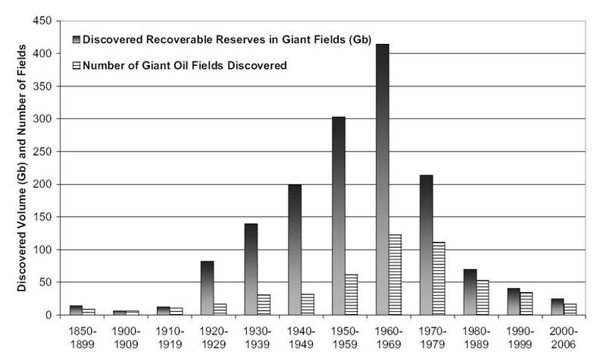
The world’s giant oilfields are in steep decline
9
Notes:
17

Slide 18
Peak oil – When will it happen?
80:20 rule – decline of the giant oil fields
The 80:20 rule of thumb is that 80% of your result comes from the 20% of your effort.
Appling that rule of thumb to oil production -we find the easy to find and produce oil first – these are the largest on shore oil fields. 94% of oil is produced by the 1500 largest oil fields in the world (out of over 40,000 fields)
This graph shows that discovery of giant oil fields peaked in the late 1960’s. Now we find very few giant (greater than 1 billion barrels) oil fields, and that rate of discovery is declining.
Source: Wikipedia
Notes:
Additional points
We have extracted the highest quality oil first – because it is worth more and is easier to produce it gives the highest return on investment.
Building oil infrastructure is very expensive. Producing from a large field is much more profitable than a small field.
This is the economic factor behind the physical geological fact of declining production from declining discovery.

Slide 19
Where we get our energy from
10
Source: ExxonMobile web site
Notes:
Source Exxon web site. Frightening how dependent we are on fossil fuels. One point many make is even is we were to double renewables, and then double and then double again, which would be a heroic achievement, it would still only represent 3% of energy requirements.

Slide 20
Why is oil so important?
It is frightening how dependent we are on fossil fuels. We have only begun the move away from fossil fuel energy.
Even if we were to double the amount of energy we get from renewables, and then double it, and then double again, which would be a heroic achievement, it would still only create 3% of current energy requirements.
Source: Exxon mobile

Slide 21
11
Why is oil so important?
How many men does it take to push a car?

Slide 22
Why is oil so important?
The phenomenal energy in petrol
A tank of petrol contains 8,000 human hours work!
If you worked for 8 hrs/day, 52 weeks a year, 7 days a week that equates to about 3 years’ work.
Most of us take for granted the amount of energy we have at our disposal instantly, everyday. No human society has ever had anything near this amount of energy before the discovery of fossil fuels and oil in particular.
Source: wikipedia
Notes:
Additional points
(If you imagine pushing a car 250 miles into a hurricane – at 70mph it would take a year for teams of 4 people to be constantly pushing the car to do the same work as one tank full)
95% of our transport is fuelled by oil. There is no replacement that is as convenient, high density, and safe.

Slide 23
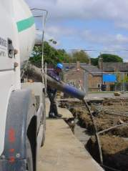
What do we use Oil for?
12
Transition Training 2009
Notes:
23

Slide 24
Why is oil so important?
What do we use oil for?
Our entire way of life, and virtually everything we use is reliant on oil.
Transport is only the beginning of our oil use.
Many products are derived from, or use oil or gas as their raw material. Plastics, synthetic fibres, drugs, laminates, paints, ink… the list is endless
The so called ‘Green revolution’ , modern agriculture depends on oil. Fertilisers and pesticides are made from oil and natural gas, tractors and machinery use it, irrigation requires huge amounts of energy and this is before food miles, processing, and storing, cooking, and packaging and retailing are taken into account.
Industry and even the service sector use huge amounts of energy.
Source: Transition training and theoilrum.com

Slide 25
Which part of this system WILL Change?
13
ECONOMY
MUST GROW
ENERGY
CAN’T GROW
ENVIRONMENT
DEGRADING
Transition Training 2009

Slide 26
Why is oil so important?
Economic growth requires growth in our energy supply, no economy has yet decoupled energy use from growth in GDP.
We have an economic system that is dependent on growth.
Therefore we are dependent on increasing supplies of energy to keep our current system going.
All forecasts of economic growth also show us using more energy.
When oil supply peaks (and the environment is degrading) we will have less total energy so economic growth will decline, probably permanently.
Source: Chris Martenson

